Slide 1
Klingons vs Romulans Creating different perceptions of the same data
Rohan Jha · Mari Pastor

Slide 2
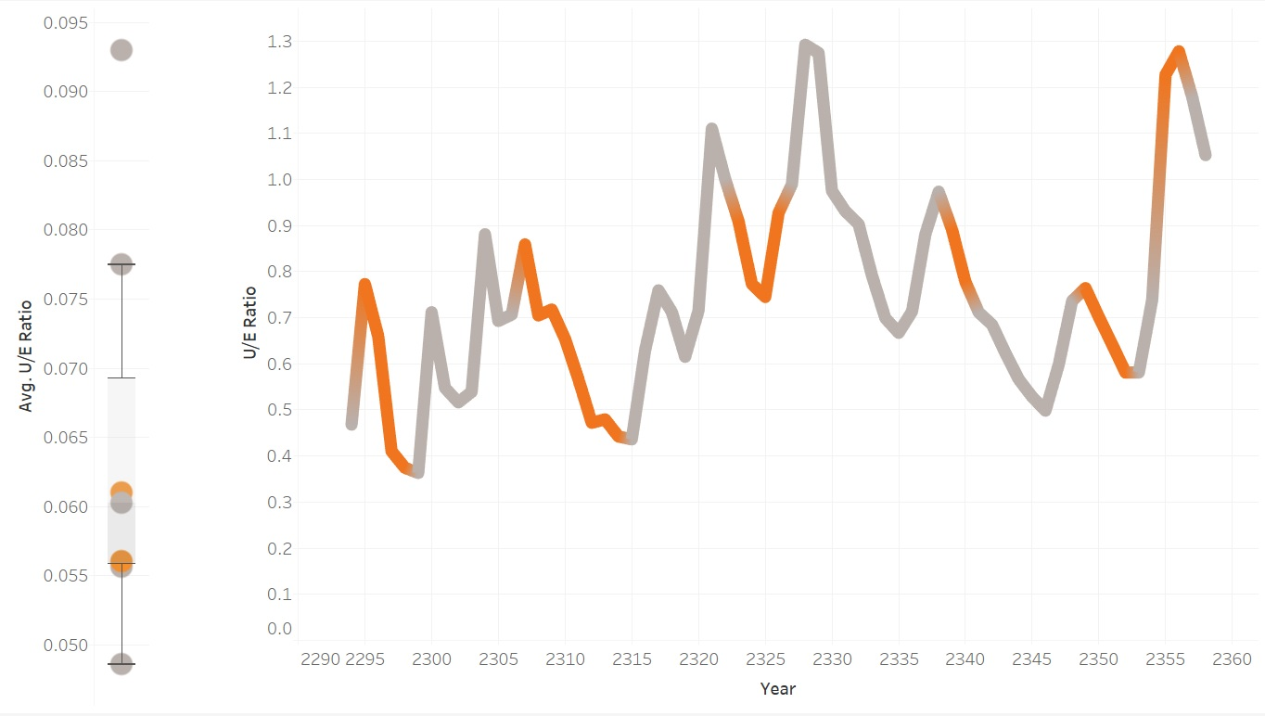
How does the economy fare when all branches of the government are controlled by same party?
Fair Assessment of the Economy

Slide 3
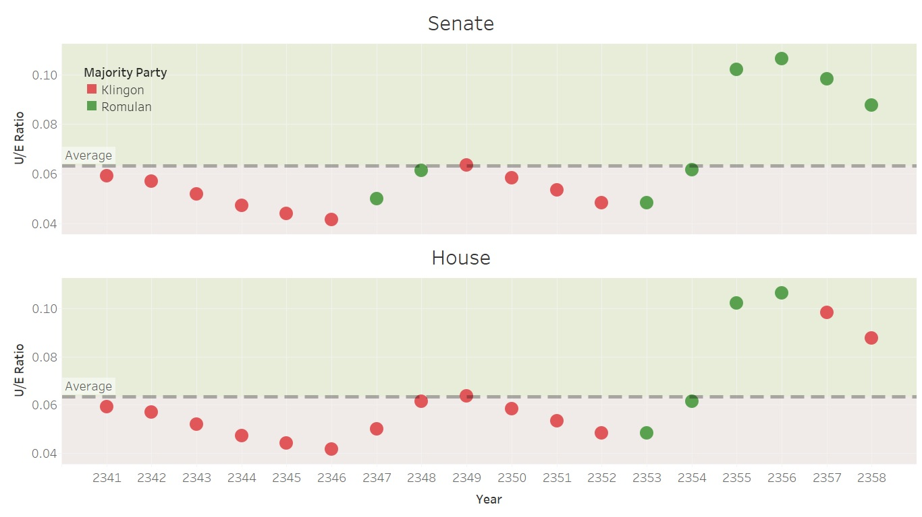
How did a Klingon-majority Senate and House benefit the economy?
Klingons are the Best!

Slide 4
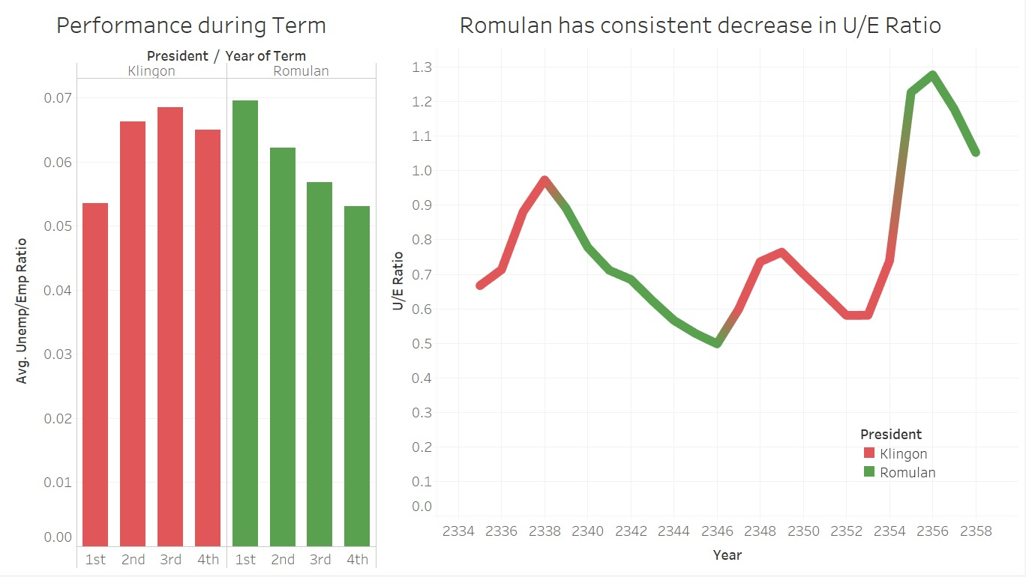
How effective have the Romulan presidents been in curbing unemployment?
No, Romulans are!

Slide 5
Explanation - Balanced
Analysis
We observed that over the long-term there wasn’t much difference between the overall performance of Klingons v/s Romulans
Hence, we decided find any interesting trend or insight that has been recurring over the years
We noticed that there was a higher decrease in unemployment to employment ratio on average during years when all branches of the government, namely President, Senate & House were in the control of a single party
We have depicted relative performance of these two kinds of governments, i.e. when all offices were held by Klingons or Romulans v/s otherwise
Design Choices
We chose a line chart as we felt it’s the best at conveying time-series data
We accompanied it with a box-plot which helps accentuate the differences in performance between the two kinds of governments that we are representing
We decided to use a bright orange hue for the interesting terms v/s a dull shade of grey for the rest of the years as it helps draw attention to the downward trend that we want to highlight

Slide 6
Explanation – Skewed in favor of Klingon
Analysis
We wanted to highlight a time when the Klingons were having a positive effect on the economy while the Romulans were having a negative effect
We decided to specifically look at the effect of the majority party in the House and Senate on unemployment as we found distinguishing patterns in them
We additionally chose to filter the data and only use the last two decades as it favored Klingons
We notice that a Klingon senate had a constantly decreasing unemployment to employment ratio while the Romulans had a constantly increasing ration except for the last two years
We see the same trend but even stronger in the case of House representation
Design Choices
We used scatter plots to represent our data as it clearly shows the trends without any clutter
We decided to represent the two parties in red (Klingon) & green (Romulan) staying true to their faction colors
We added an average line on the plot to highlight the fact that the Klingons managed to consistently stay below
We additionally chose to apply lighter hues as background colors to accentuate the fact that the lower portion of the chart belongs to Klingons

Slide 7
Explanation – Skewed in favor of Romulan
Analysis
We wanted to highlight a time when the Romulans were having a positive effect on the economy while the Klingons were having a negative effect
We decided to specifically look at the trends of unemployment across various presidential terms
We additionally chose to filter the data and only use the last three decades as it favored Romulans
We can see that during Romulan presidency, the unemployment to employment ratio has consistently decreased which is in stark contrast to the Klingon performance
We also decided to drill-down on each presidential term, and observe how the unemployment trends looked as the term progressed
We notice that Romulan presidential terms showed a decline in U/E ratio (from first year of term towards the final)
Design Choices
We decided to use a line chart to show the time-series data effectively, with different colors representing each party
For the drill-down analysis, a bar chart is used as it helps to do a comparative analysis better
As before, we use the original faction colors to represent the data as Klingon or Romulan

Slide 8
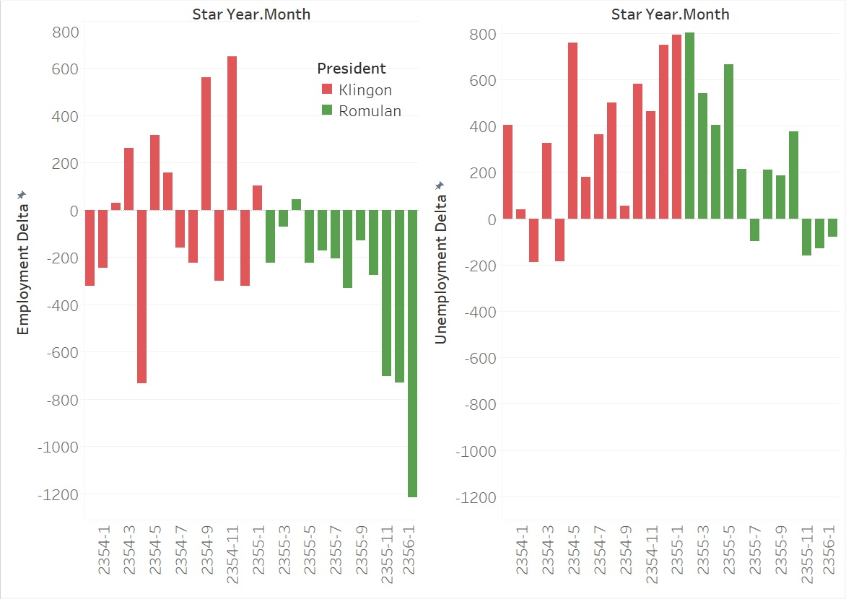
Sneaky Romulans!
The Romulans have plotted Job Loss on the y-axis, and tried to represent an increasing trend since their new president took over
The plot shows mainly negative values for Job Loss which translates to Job Growth
They are trying to hide the fact that increasing job loss is a negative trait, and instead trying to represent Klingons as being deficient
We have tried to show what fair representations of the same data would look like
We see that there is a huge spike in loss of employment in the last month for Romulans

